Slide 1
COP 27 Loss and Damage: half way along a long road
“The loss and damage fund is a response to climate injustice and climate debt, owed by the rich countries to the poor,”
Meena Raman, Head of Programmes at Third World Network. 8 Dec 2022
Gill Miller

Slide 2
Definitions
Loss indicates irreversible damage, such as land loss because of sea-level rise or loss of freshwater resources because of desertification.
Damage involves reparable harm such as shoreline or infrastructure impacts linked to climate change.
Distinguish between economic losses and non-economic losses.

Slide 3
The story begins..
1991 – Alliance of Small Island States called for mechanism to compensate for sea-level rise. Vanuatu proposed an insurance scheme for loss and damage.
2010 COP 16 – Concept of L&D accepted.
2013 COP 19 Warsaw International Mechanism on Loss and Damage (WIM)
2015 Paris Accord – Article 7 on Adaptation and Article 8 on L&D accepted as pillars in the agreement

Slide 4
Warsaw International Mechanism on Loss and Damage (WIM) 2013
Aims
To address L&D associated with impacts of climate change especially a) extreme events (hurricanes, heat waves)
b) slow-onset events (desertification, sea level rise, ocean acidification)
In developing countries esp vulnerable to climate change.
Focus was on knowledge & understanding of risk management strategies, coordination between stakeholders, finance, technology & capacity building

Slide 5
Warsaw International Mechanism on Loss and Damage (WIM) 2013
Actions
Assess L&D
Options for risk management strategies
Data collection
Encourage an investment environment
Involve vulnerable communities
Share data to help manage climate risks
2 years to implement these actions……

Slide 6
2015 - 2020 slow progress
More focus on reducing climate change
Then came realisation that impacts of climate change > adaptation & risk management capabilities, especially on SIDS and low income countries
Problem-
no process in place to help these SIDS, LICs.
no evaluation of progress
no sense of what support was needed

Slide 7
2017 – IPCC report “too complicated”.
L&D limited to residual risk, adaptation limits, attribution
2019 – IPCC Special Report on Land and Oceans - recognition of what L&D was attributable to climate change.
Accumulation of evidence, scientific information - needed for policy makers
2019 COP 25 Madrid – Review of WIM – stronger commitment for action & support, including additional finance.
BUT – promises from developed states failed to materialise.
2021 COP 26 – recognition that failure of developed countries would no longer be ignored

Slide 8
What is Loss and Damage finance?
Major political controversies. Some DCs consider adaptation only.
Adaptation finance (Green Climate Fund) takes 1 year from submitting a proposal to getting the money.
e.g. many activities that minimise or avert L&D (ie risk reduction activities) can be financed through adaptation.
Problem of lack of definition. Loopholes – e.g. losses after productive cropland has become unproductive.
L&D finance needs to be short notice.
No mechanism for L&D from slow-onset events – desertification, salinisation, sea level rise

Slide 9
Adaptation - anticipating the adverse effects of climate change and taking appropriate action to prevent or minimise the damage they can cause, or taking advantage of opportunities that may arise.
e.g. large-scale infrastructure changes, such as building defenses to protect against sea-level rise
behavioral shifts - reducing their food waste.
process of adjusting to the current and future effects of climate change.
Mitigation - making the impacts of climate change less severe by preventing or reducing the emission of greenhouse gases (GHG)
e.g reducing the sources of these gases - sustainable energy, transport
enhancing the storage of these gases — increasing the size of forests
mitigation is a human intervention that reduces the sources of GHG
emissions and/or enhances the sinks

Slide 10
Glasgow COP 26
G77 + China agreed Glasgow Climate Pact
But developed countries resisted. Unresolved but promised to discuss during next 3 years.
Creation of Santiago Network on L&D - technical body without the ability to address the reality of loss and damage on the ground.
Increased public awareness of L&D within civil society, press
2022 – extreme weather events – catastrophic L&D
Acceptance of L&D as a human rights issue – legal international obligations.
ESCR–net: International Network for Economic, Social & Cultural Rights

Slide 11
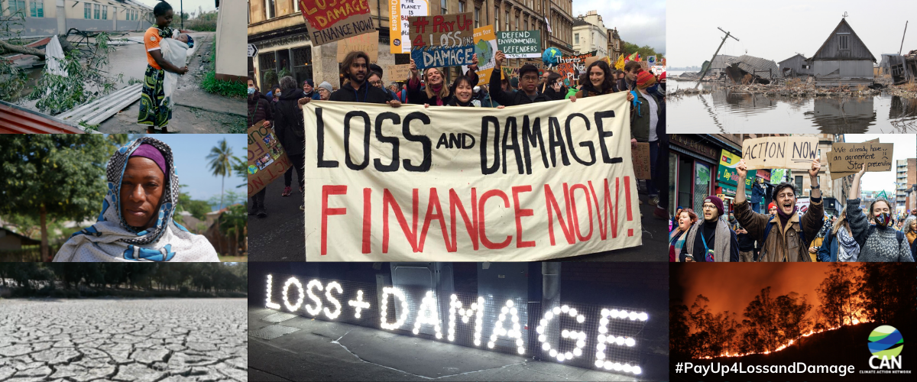
COP 27
Agreement to have a Loss & Damage fund.
How? Where from? How will it work?
Operationalisation of Santiago Network to deliver of WIMs 3rd function
“Identify and catalyse opportunities to mobilize technical assistance to address loss and damage resulting from climate change.”
Human Rights approach – focus on women, indigenes, children
Recognition of need for finance – details during coming year.

Slide 12
Bridgetown Initiative
Rich countries provide < $100bn/yr in loans & grants.
Need is $trillions.
Devised by Mia Mottley, PM of Barbados
Supported by Macron and IMF
Global Climate Mitigation Trust – SDNs Special Drawing Rights
One-off $650bn from IMF
$1trill from development banks in low-interest loans for climate spending
[standard borrowing LDCs = 12-14%; G7 = 1-4% ]
+ tax on oil companies to finance reconstruction grants for LDCs after disasters – L&D fund
+ after climate disasters, outstanding loan repayments to be temporarily paused.
Precedent from IMF -
UK after WW1. Germany after WW2.

Slide 13
Key premise: low income countries should not be forced to sacrifice their development goals for climate spending.
How to assess impact of climate change?
E.g Pakistan floods: $30bn damage, 9% GDP. Caused by natural climatic variation La Niña. But rain made worse by greenhouse gases.
Where would the money go? Particularly vulnerable countries? All developing countries?
Loans can be risky – hence high interest rates.
SIDS do not have affordable insurance. Borrow when affected by disasters, at crazy interest rates.

Slide 14
Adaptation due to migration? “Oasis zones” in Global North. Who helps to finance substantial migration from climate-induced inhospitable areas? Does that count for financial support? [Parag Khanna “Move: the forces uprooting us”

Slide 15
How does IMF ensure money is spent effectively?
How do you calculate loss due to climate change?
e.g.Jamaica
Coastal mangrove swamps protect coast from severe damage. Cleared for fuel – increased impact of storms – increased impact of storms inland – more flooding of homes & farmland.
More severe storms make this worse.
Who administers?
On what criteria?
Back to the need for scientific evidence, technical know-how & research. WIM
This takes time.
Extreme events are upon us

Slide 16
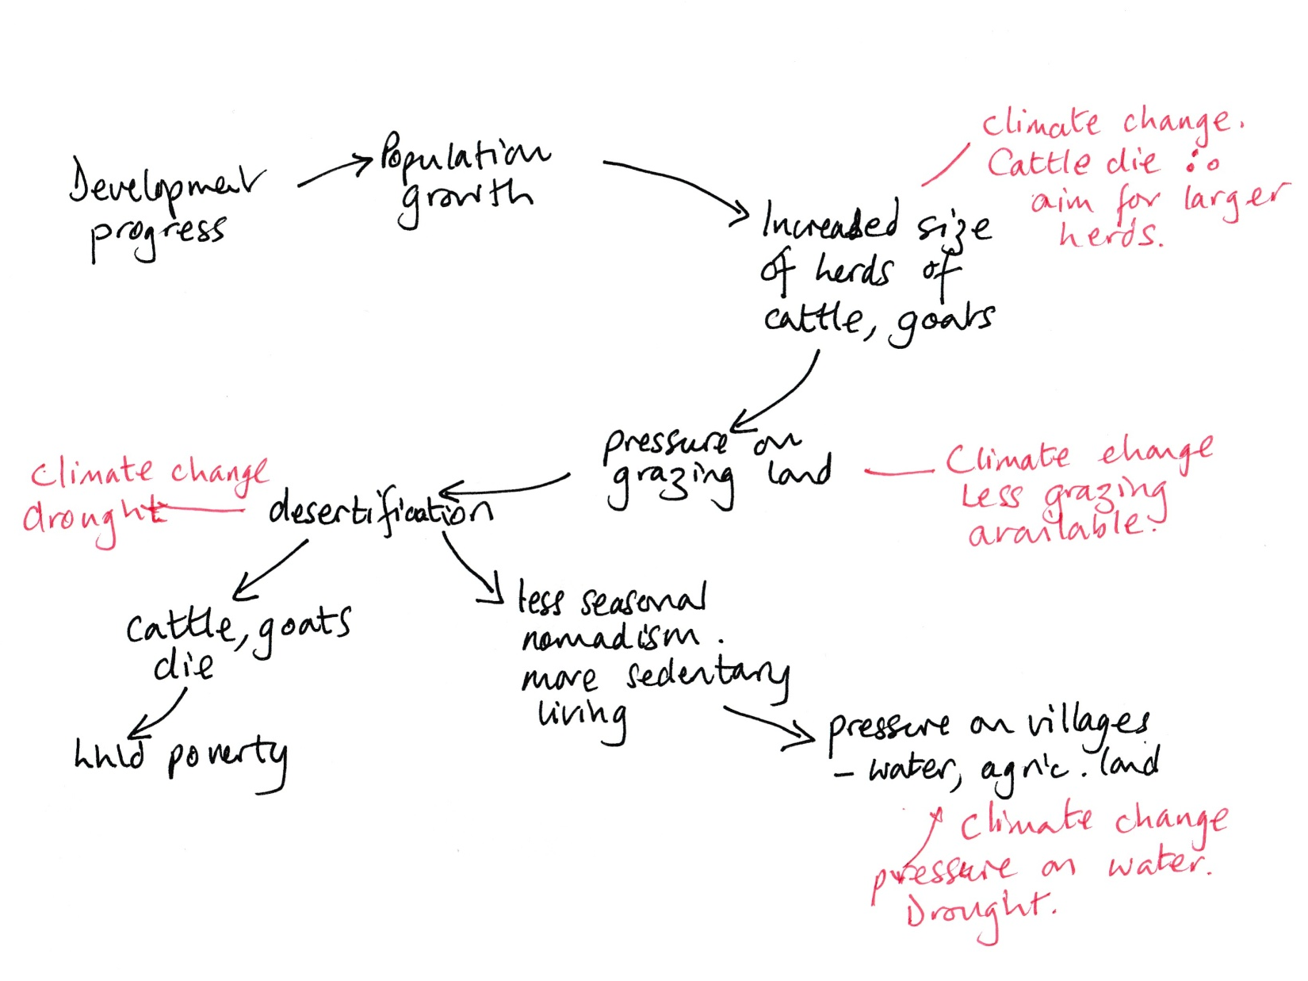
Where do you start? Climate change impacts in Sahel
Importance of cross-over funding

Slide 17
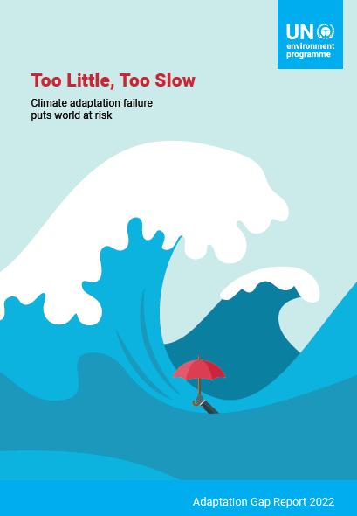
Selection of key messages
Strong mitigation & adaptation is vital.
8/10 countries have some sort of national adaptation plan, getting better & more inclusive.
Adaptation finance flows are 5–10x below what is needed, and gap is widening.
Adaptation actions not keeping up with climate change.
Adaptation & mitigation together will bring even more co-benefits.
Some climate solutions reduce climate risk and contribute to mitigation, especially nature-based solutions such as planting & conserving mangroves, restoring salt marshes & protecting peatlands.
Strong political will is essential.
https://www.unep.org/resources/adaptation-gap-report-2022

Slide 18
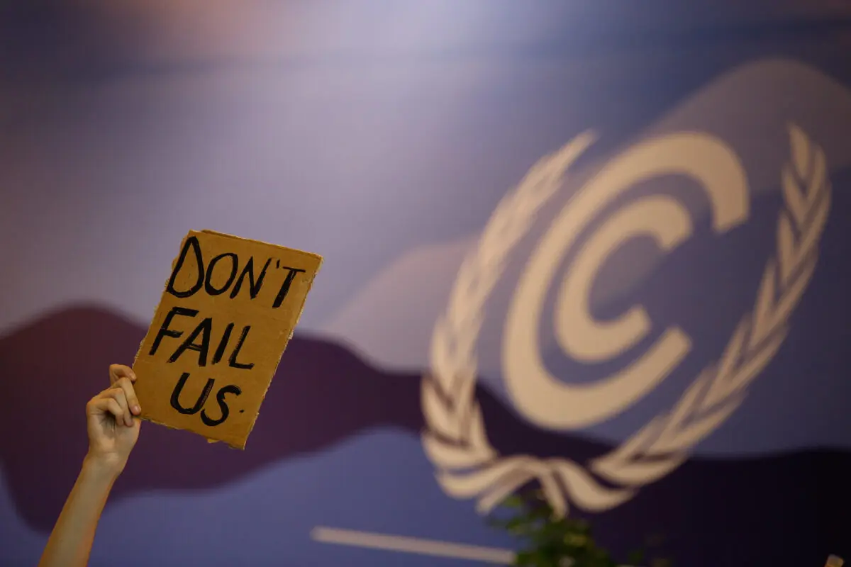
What is the way ahead?

